Slide 1
Plant and Soil Interactions

Slide 2
If so, what do they need to replace soil?
Can plants live without soil?
Soil provides plants:
A substrate to grow in
Support
Nutrients
Water
Air
Plants can grow without soil (hydroponics, aquaponics), but need special structures and fertilizers

Slide 3
How do plants impact the soil?
Plant growth protects the soil surface
Root growth holds onto the soil and protects it from erosion
Root growth helps build soil structure, create pore spaces, and mitigate compaction
Plant matter adds organic material to soil, feeding insects and microbes
Plant matter returns nutrients back to soil
If not managed well, plants can remove too many nutrients from the soil

Slide 4
Experiment: What do plants get from soil?
 | Plant | Substrate | Nutrients | Water | Light
Control | Soybean | None | None | None | Windowsill
1 | Soybean | Soil | Plant food | 3-5 days | Windowsill
2 | Soybean | Soil | None | None | Windowsill
3 | Soybean | Soil | None | 3-5 days | Windowsill
4 | Soybean | Soil | Plant food | None | Windowsill
5 | Soybean | Water | None | -- | Windowsill
6 | Soybean | Water | Plant food | -- | Windowsill

Slide 5
Discuss
What are the constants and variables in the experiment?
What will they tell us?
What do you hypothesize will happen?
How will each of the plants do? Why?

Slide 6
Cellular Respiration
Cellular respiration is a set of metabolic reactions and processes that take place in the cells of organisms to convert biochemical energy from nutrients into ATP, and then waste products.
Think about it this way: photosynthesis captures and stores the sun’s energy, where cellular respiration breaks down the energy and uses it

Slide 7
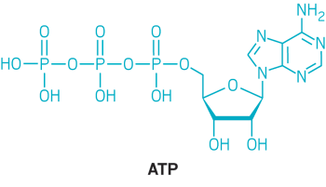
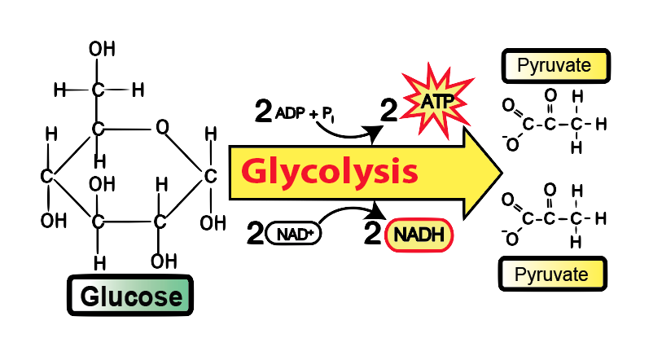
Glycolysis – The First step of Cellular Respiration
Glucose doesn’t have phosphorus or nitrogen. Where do these elements come from?
The product of photosynthesis

Slide 8
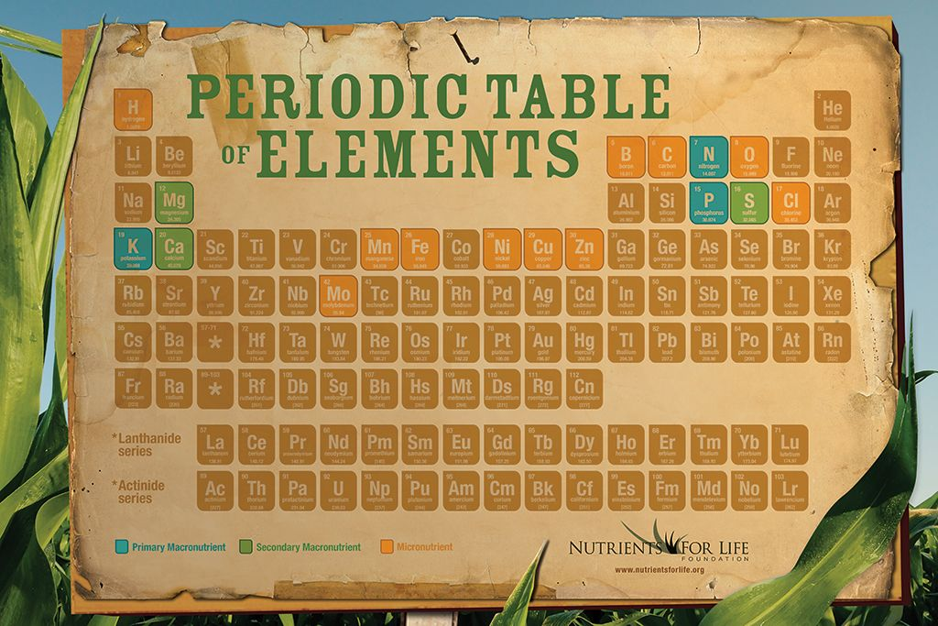
Essential Nutrients
Nutrients that a plant can’t synthesize and needs to absorb
Macronutrients:
Carbon, hydrogen, oxygen, nitrogen, phosphorus, potassium, calcium, magnesium, sulfur
Micronutrients:
Chloride, iron, boron, manganese, zinc, copper, molybdenum, nickel

Slide 9
Journal prompts:
How does the plant growth experiment show the importance of absorbing nutrients to plant growth?
Explain the importance of nutrient absorption to cellular respiration.
What does soil provide for plants?

Slide 10
How do plants impact soil?

Slide 11
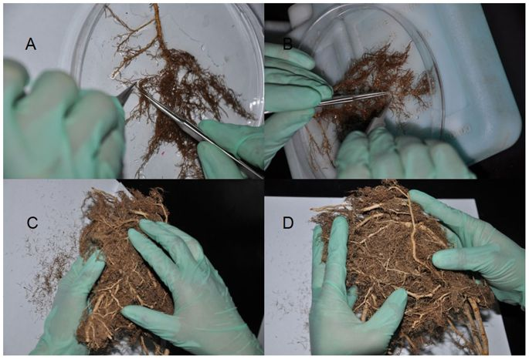
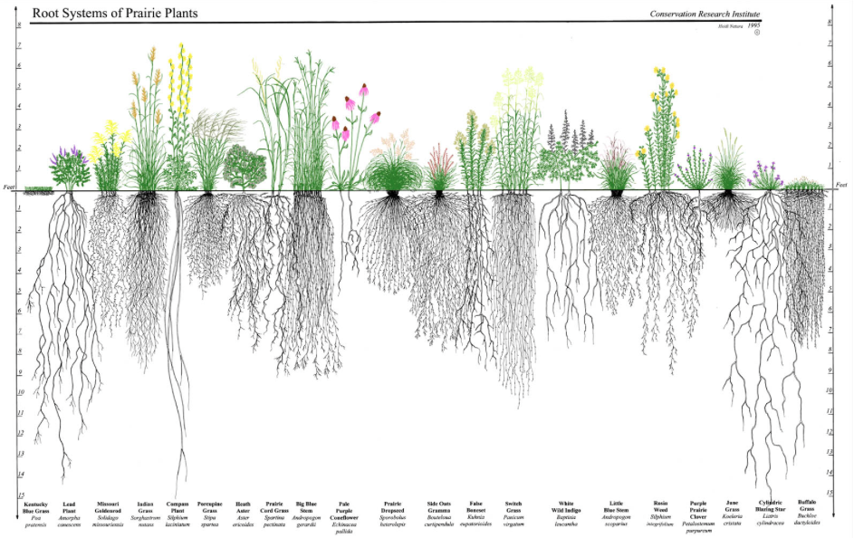
Expose the Root Structures

Slide 12
A Root’s Purpose
Essential nutrients cannot be synthesized by an organism – they must absorb it.
Roots must absorb essential nutrients to grow and survive.
How does a plant do that?
How Do Trees Transport Water from Roots to Leaves? | California Academy of Sciences

Slide 13
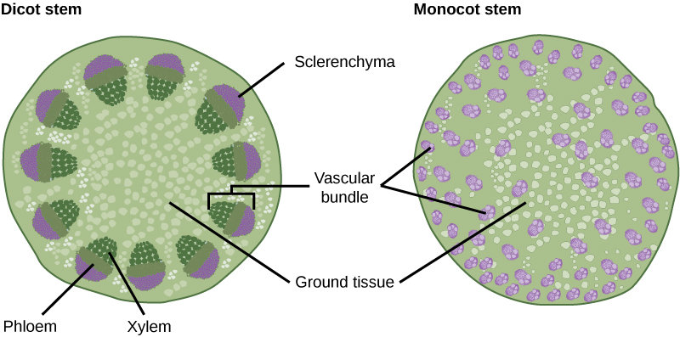
How Nutrients Move
The outermost layer of a root is semipermeable
This allows water and nutrients to be collected
The xylem and phloem are the primary transportation system in a plant
They are tubes that carry water and nutrients throughout the plant
They run from the roots to the leaves and back again
Broadleaf plants
Grasses

Slide 14
How do plants impact soil?
Roots hold soil in place
Plant growth protects soil surface
Roots create pore space in soil
Plant matter creates organic matter that feeds insects and microbes
Different root structures aerate the soil or mitigate compaction differently
Roots aid in soil structure formation

Slide 15
Journal prompts:
What are the purposes of roots?
How do plants send water and nutrients throughout the organism?
How can root structures differ?
How to plants impact soil?

